Slide 1




Effective Microservice Communication and Conversation Patterns
Jimmy Bogard
@jbogard
github.com/jbogard
jimmybogard.com

Slide 2
Microservice: An independently deployable service modeled around a business domain.
Notes:
Communicate via networks, may offer
An opinionated service-oriented architecture

Slide 3
Messaging IRL

Slide 4
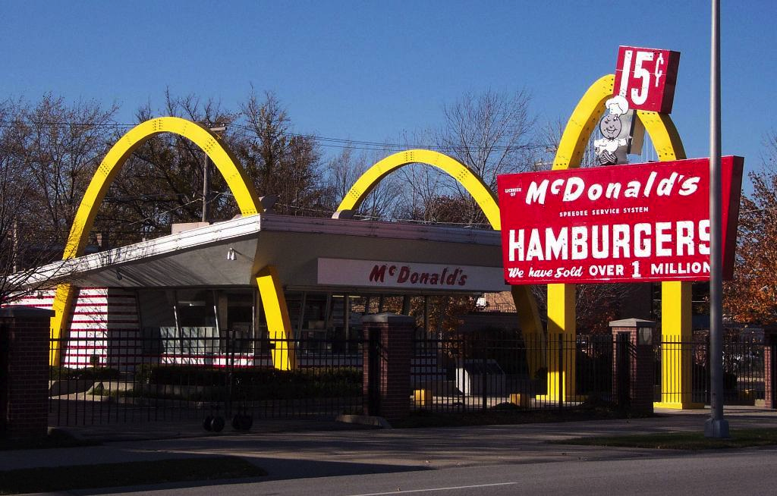
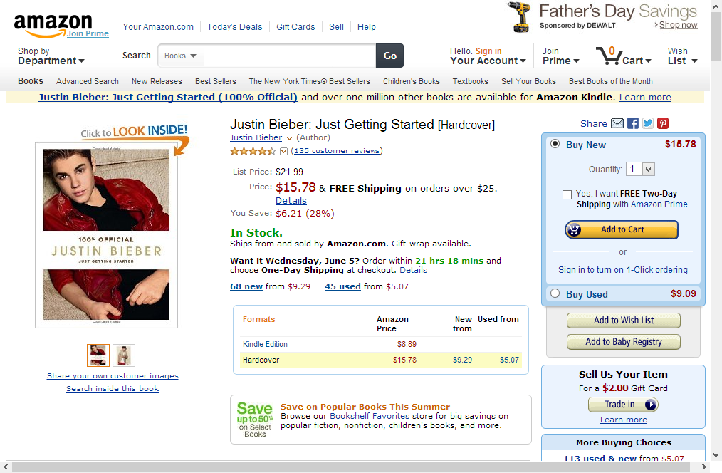


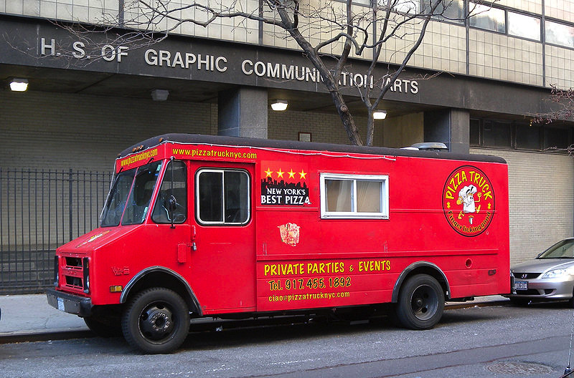
Scaling reality

Slide 5
Starting small
Everything done by one person
Everything synchronous
Everything in-process
Dress
Grill
Pack
Menu

Slide 6
Sound familiar?
UI
BLL
DAL
DB
Notes:
Every request synchronous to the browser

Slide 7
Business model
Take order – 30 seconds
Dress – 10 seconds
Grill – 100 seconds
Pack – 10 seconds
Total time: 150 seconds
Max orders per hour: 24
Dress
Grill
Pack
Menu

Slide 8
Further complications
People don’t like to wait
Long lines = people walk away
Can’t assume constant rate of flow
30 per hour does not imply 1 person every 2 minutes
Dress
Grill
HALP
Pack
Menu
wtf is going on in there

Slide 9
Solution: Hire more workers!
Each person does 1 job
Some can start several items in parallel
Ordering the only bottleneck now
Max orders per hour: 120
Dress
Grill
Pack
Menu

Slide 10
Problem: How do we fulfill an order?
Transaction no longer synchronous
How do later steps know what to do?
How do we know when we’re done?
Solution: messaging
Dress
Grill
Pack
Menu

Slide 11
First interaction: placing order
Information needed from customer: what food you want
Need to know how to notify customer that order is ready
Synchronous – Cashier and customer blocked during interaction
Non-durable – order is requested verbally
Dress
Grill
Pack
Menu

Slide 12
First interaction: placing order
POST /order
{
“name” : “Jimmy”
“item” : “Taco”
}
HTTP/1.1 201 Created
Location: /order/23
Dress
Grill
Pack
Menu

Slide 13
Patterns Used?
POST /order
{
“name” : “Jimmy”
“item” : “Taco”
}
HTTP/1.1 201 Created
Location: /order/23
Dress
Grill
Pack
Menu

Slide 14
Synchronous Request/Response
POST /order
{
“name” : “Jimmy”
“item” : “Taco”
}
HTTP/1.1 201 Created
Location: /order/23
Dress
Grill
Pack
Menu

Slide 15
Next interactions: how to manage?
Durable or non-durable?
Who manages the steps?
How do we manage failures?
Dress
Grill
Pack
Menu

Slide 16
Synchronous Request/Response?
POST /dress
{
“order” : “/order/23”
}
HTTP/1.1 200 OK
Dress
Grill
Pack
Menu

Slide 17
Synchronous Request/Response?
POST /dress
{
“order” : “/order/24”
}
…?
bleep bloop I’m busy
Dress
Grill
Pack
Menu

Slide 18
Request/Response with Retry?
POST /dress
{
“order” : “/order/24”
}
HTTP/1.1 503 Service Unavailable
bleep bloop I’m busy
Dress
Grill
Pack
Menu

Slide 19
Request/Response with Retry?
POST /dress
{
“order” : “/order/24”
}
HTTP/1.1 200 OK (jeez)
ok now i can do it
Dress
Grill
Pack
Menu

Slide 20
Idempotency and exactly-once processing
POST /dress
{
“order” : “/order/24”
}
HTTP/1.1 200 OK (jeez)
was that the same order?
Dress
Grill
Pack
Menu

Slide 21
Fire-and-forget?
POST /dress
{
“order” : “/order/24”
}
HTTP/1.1 202 Accepted
gotcha thanks
Dress
Grill
Pack
Menu

Slide 22
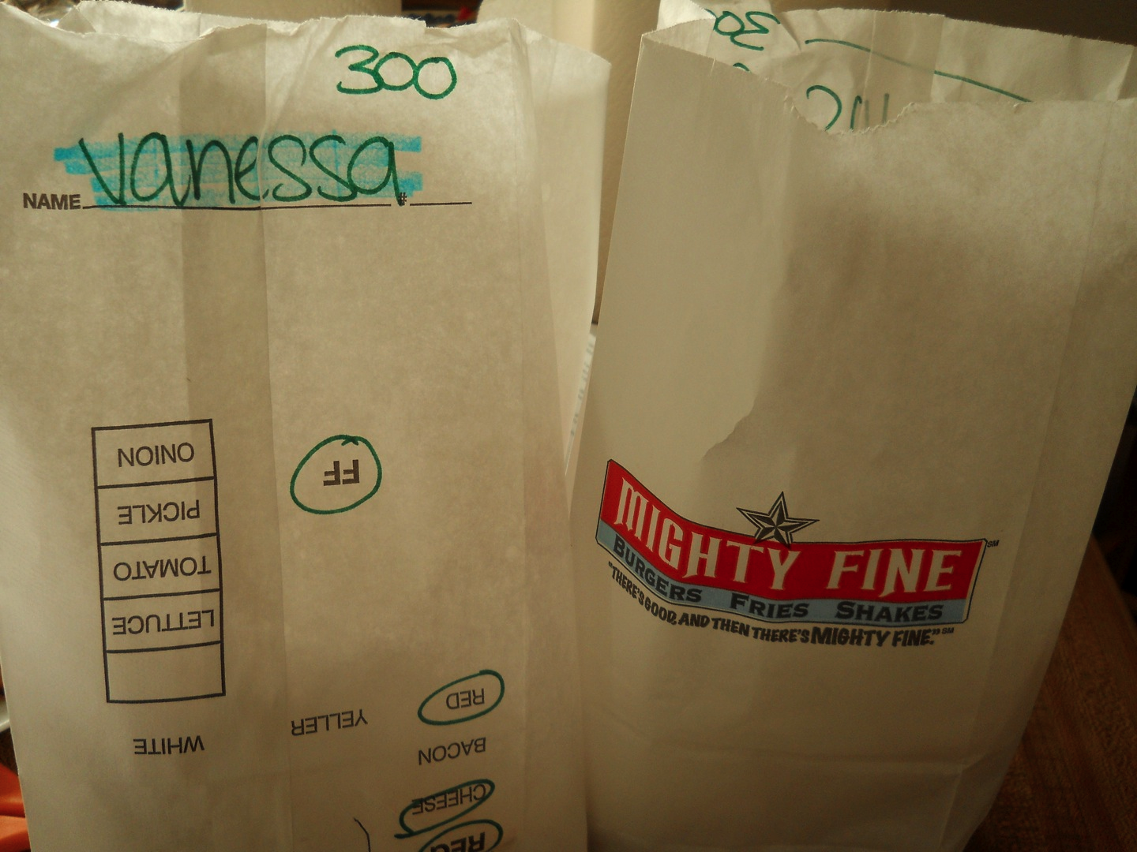
Order Flow IRL
Dress
Grill
Pack
Menu

Slide 23
Routing Slip
SEND Dress
{
“Order”: “/order/23”
“Steps”: [“Dress”,
“Grill”,
“Pack”]
}
Dress
Grill
Pack
Menu

Slide 24
Managing backlogs of work
Queues for each step
Asynchronous, durable messages allow temporal decoupling
Independence maintained
Dress
Grill
Pack
Menu

Slide 25
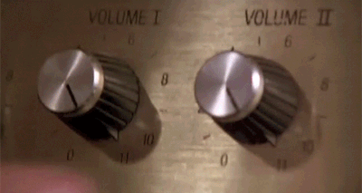

Slide 26

Larger Chains?
Grill
Fryer
Many steps are independent
Some are not
Steps vary per order
How to manage?
Drinks
More Drinks
Dress

Slide 27
Taking Order
Grill
Fryer
POST /order
{
“name” : “Jimmy”
“item” : “Taco”
}
HTTP/1.1 201 Created
Location: /order/23
Drinks
More Drinks
Dress

Slide 28
Processing Order?
Grill
Fryer
Synchronous untenable
Routing slip too inefficient
Solution: Conversation pattern!
Drinks
More Drinks
Dress
???

Slide 29
Step 1: Publish
Grill
Fryer
PUBLISH OrderCreated
{
“Order”: “/order/23”
}
Drinks
More Drinks
Dress

Slide 30
Tracking Completion
Grill
Fryer
Physical tray holds items
Receipt on tray shows details
How to coordinate?
Drinks
More Drinks
Dress

Slide 31
Step Completion
Grill
Fryer
Place item on tray
Check items on receipt for done-ness
nope not done
Drinks
More Drinks
Dress

Slide 32
Step Completion
nope not done
Grill
Fryer
Place item on tray
Check items on receipt for done-ness
Drinks
More Drinks
Dress

Slide 33
Step Completion
looks good, ship it!
Grill
Fryer
Place item on tray
Check items on receipt for done-ness
Drinks
More Drinks
Dress

Slide 34
Choreography
looks good, ship it!
Grill
Fryer
Event-based initiation
Step order not enforced
Tracking completion required
“Observer”
Drinks
More Drinks
Dress

Slide 35
How to deliver?
looks good, ship it!
Grill
Fryer
Need some way to correlate orders with people
Natural correlation (Name)
Artificial correlation (Number)
Drinks
More Drinks
Dress

Slide 36
Larger Restaurants
Grill
Fryer
Orders much more complex
Timing matters
Need much more control over process
Other Grill
Grill
Dress

Slide 37
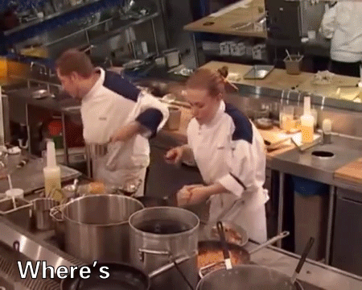

Slide 38
Benevolent* Dictator - Chef
Grill
Fryer
Receives incoming orders from waitstaff
Creates plan for completion
Barks orders at people at specific points of time
Other Grill
Grill
Dress

Slide 39
Starting Order with Waitstaff
Grill
Fryer
POST /order/23/items/add
{
“item”: “burger”
}
HTTP/1.1 200 OK
Other Grill
Grill
Dress

Slide 40
Starting Order with Waitstaff
Grill
Fryer
POST /order/23/items/add
{
“item”: “fries”
}
HTTP/1.1 200 OK
Other Grill
Grill
Dress

Slide 41
Starting Order with Waitstaff
Grill
Fryer
POST /order/23/items/add
{
“item”: “pint of ale”
}
HTTP/1.1 200 OK
Other Grill
Grill
Dress

Slide 42
Finishing Order Request
Grill
Fryer
POST /order/23/finish
HTTP/1.1 202 ACCEPTED
Other Grill
Grill
Dress
now for the chef *gulp*

Slide 43
Starting Order Fulfillment
Grill
Fryer
PUBLISH OrderReady
{
“id”: 23
}
Other Grill
Grill
Dress

Slide 44
Coordinating Work
Grill
Fryer
SEND MakeBurger
{
“id”: 23
}
Other Grill
Grill
Dress

Slide 45
Coordinating Work
Grill
Fryer
SEND PourPint
{
“id”: 23
}
Other Grill
Grill
Dress

Slide 46
Coordinating Work
Grill
Fryer
SEND PintComplete
{
“id”: 23
}
Other Grill
Grill
Dress

Slide 47
Coordinating Work
Grill
Fryer
SEND DeliverPint
{
“id”: 23
}
Other Grill
Grill
Dress

Slide 48
Coordinating Work
Grill
Fryer
SEND MakeFries
{
“id”: 23
}
Other Grill
Grill
Dress

Slide 49
Coordinating Work
Grill
Fryer
SEND BurgerComplete
{
“id”: 23
}
Other Grill
Grill
Dress

Slide 50
Coordinating Work
Grill
Fryer
SEND FriesComplete
{
“id”: 23
}
Other Grill
Grill
Dress

Slide 51
Coordinating Work
Grill
Fryer
SEND DeliverOrder
{
“id”: 23
}
Other Grill
Grill
Dress

Slide 52
Orchestration
Grill
Fryer
Process started by single message
Commands to coordinate
Request/response to indicate completion
Less tracking of status
Other Grill
Grill
Dress

Slide 53
Orchestration vs Choreography
Grill
Fryer
Analyze process flow and coupling
Orchestration (usually) inside service boundaries
Choreography (usually) between service boundaries
Other Grill
Grill
Dress

Slide 54
What about our reads?

Slide 55
Catalogs and menus
Reading menu is cheap
Menu built for customers
Decisions on building menu not visible to customers
Dress
Grill
Pack
Menu

Slide 56


Creating the menu
Optimized for managing the menu
Decisions and business rules
Calculations and forecasts
Historical trends

Slide 57
Typical solution
Front end
Back
end
DB

Slide 58
Equivalent design
Same model to solve two very different problems
Two very different characteristics
Want two different solutions
Dress
Grill
Pack
wtf is going on in there

Slide 59
Better solution
Front end
Back
end
DB
DB
?

Slide 60
Interactions
Updating menu on a scheduled basis
Menu is immutable
Data is duplicated but ownership preserved
Dress
Grill
Pack
Menu

Slide 61
Publishing changes
PUBLISH MenuUpdated
{
“Date”: “2020-01-30”,
“Items”: [
{ “Name”: “Taco”,
“Price”: 1.49 },
…
]
}
Dress
Grill
Pack
Menu

Slide 62
Multiple subscribers
Publisher keeps track of subscribers
Durable format
Publishing creates message per subscriber
Store A
Store B
Stores
…
…
Store C

Slide 63
Characteristics
Durable message to subscribers
Subscribers unaware of each other
If one store is closed, other menus continue to be updated
Store A
Store B
Stores
…
…
Store C

Slide 64
Parting thoughts
Constraints of real world haven’t changed – the latency is just shorter
Solutions from real world apply directly to a distributed world
Real world solved distribution problems with messaging and conversation/coordination
And so can you!

Slide 65
Effective Microservice Communication and Conversation Patterns
Jimmy Bogard
@jbogard
github.com/jbogard
jimmybogard.com

